Slide 1
Cognition Fundamentals: Kick-off
What is Cognition and how did it develop as a field?
Responsible Lecturer: Bram Heijligers

Slide 2

A lecture...
About cognition? But we’re making robots not humans...
Notes:
Well, here you are: sitting down, attending a lecture. Not really very remarkable, you might think—initially. What’s more, the lecture is about cognition, a topic you might be expecting to find dull and hardly relevant to what people usually expect artificial intelligence to be about. Is cognition really that important? If so, are they really as interesting as other aspects of artificial intelligence?
Let us consider this by asking some questions. How did you hear about this study? Why did you decide to enroll? Perhaps someone told you about it. How do you remember who told you? Would you recognise that person if you saw them again? How did you understand what they said to you? If you had to go to the ADSAI website, how did you know what to do there, or how use the project brief overview? How do you know what a the right content for which day looks like and where to find it? How did you avoid walking into people on your route? How did you read the words on the slide on the board? And how do you remember what they mean? If you don’t and want to google them, how do you manage to reach for your phone or keyboard rather then your water bottle?

Slide 3
Cognition: Attention, Perception, Memory
Cognition VS Psychology
Cognitive science is concerned with the changes occurring in the nervous system when an individual performs some high level cognitive function. It aims at studying how different parts of the brain work in tandem to produce a particular reaction to a given stimulus. The field is more research based.
Psychology on the other hand deals with people with feelings and does not look at them as research objects only. It is more interventional in nature. It helps people to work on their thinking to improve their behaviour in society.
Notes:
The answers to these questions involve attention, perception and memory. Let’s take a moment to read the text on screen.
Now, while you are reading, you are moving your eyes along the lines of text—effortlessly. You are paying attention to reading; you perceive the words and know what they mean because you have learnt them and they are stored in your memory. As you read on you may learn new things that will also become stored in memory, but how will you be able to recall what you have learned when it comes to applying it to the project brief?
The environment provides a rich source of information; ofsights, sounds and smells, and we perceive it all around us. We attend to parts that interest us, look around it, make actions in it and upon it. We can remember what we did and what we heard and who we saw some time later. In this complex environment we need to know who we are, where we are, what is around us and where things are in relation to each other and to us. We need to decide whether what we detect is important, and how we should respond to it. All these things seem so familiar, simple and effortless it would be easy to think there is little to explain—we just ‘do’ them. However, the way we are able to encode, interpret and respond to the complexity of stimuli around us does need explanation. This is an exciting and challenging task, and it is at the heart of the questions asked by cognitive scientist and it is what you need to define in code to create a robot!

Slide 4
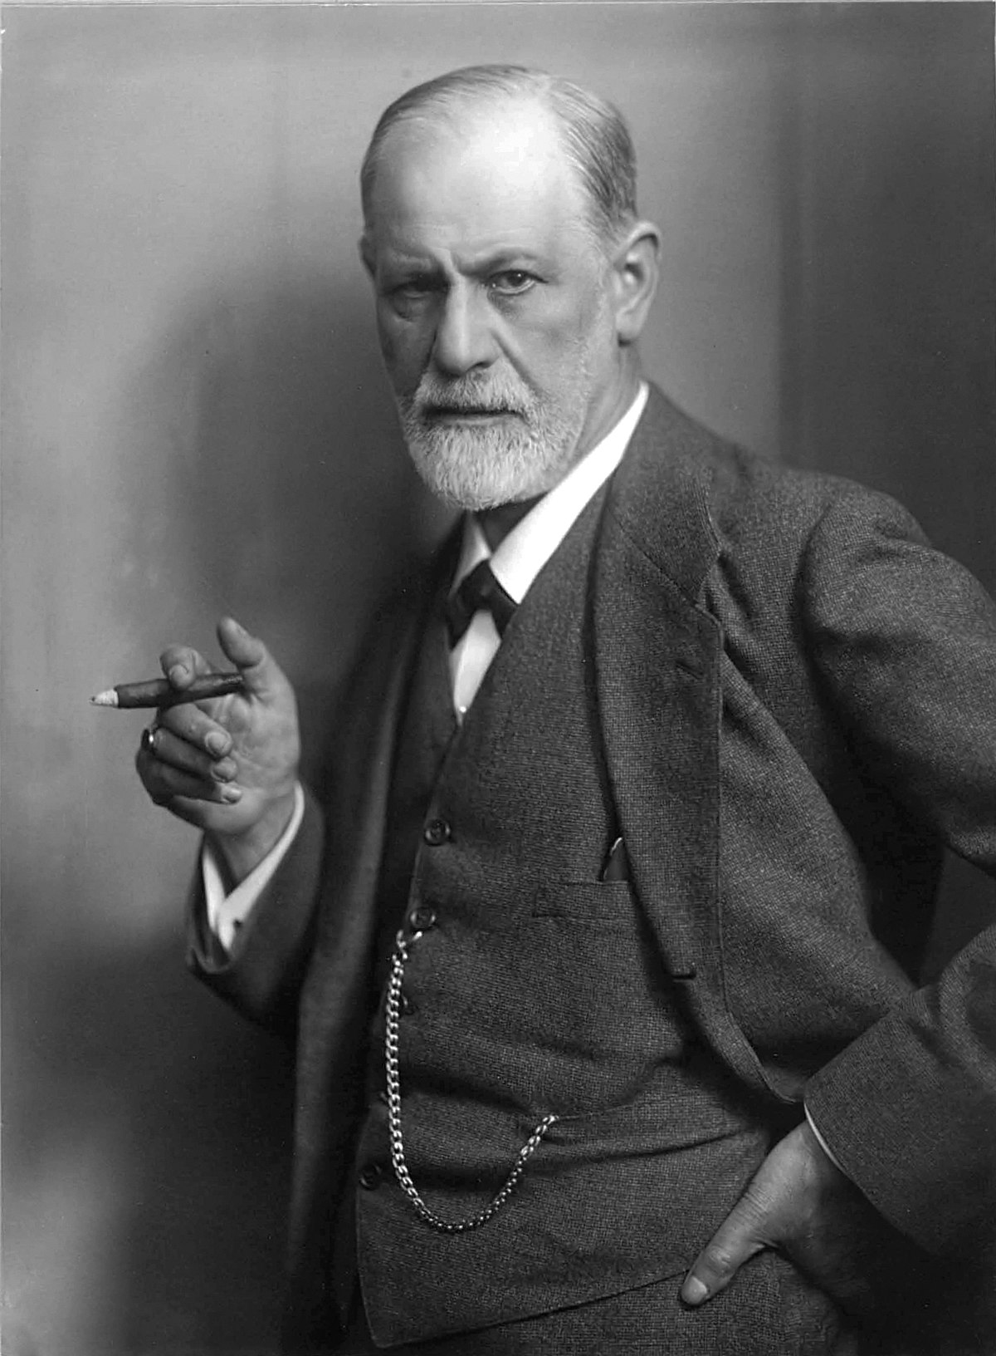
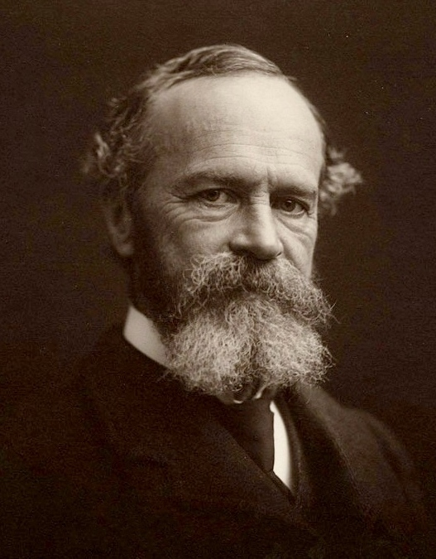
In the beginning...
Introspection Behaviourism
Measuring the mind by looking into one’s consciousness
E.g. Self-reflection
Sigmund Freud’s approach
Measuring the mind by registering behaviours
Stimulus-Response relationships
E.g exams
But how to quantify the mind itself remaind a mystery
Notes:
When psychology first began it was believed that it should be the study of conscious experience. *Talk about introspection*
The early psychologists such as William James (1890) appreciated the intimate relationship between attention, perception and memory, and produced some of the best subjective descriptions of the contents and operations of the mind. Even before James, other researchers attempted to measure the units of sensation that they believed made up the primitive units of experience. For many years the study of the contents of mind were abandoned as impossible to measure scientifically while the Behaviourist movement concentrated on stimulus–response relationships.

Slide 5
But then...
Computers & information processing
Cognition: the mind as a computer
Input – Processing – Output
Simply put: how we know things
Immanuel Kant
Sensation is organized stimuli
Perception is organized sensation
Conception is organized perception
Science is organized conception

Slide 6
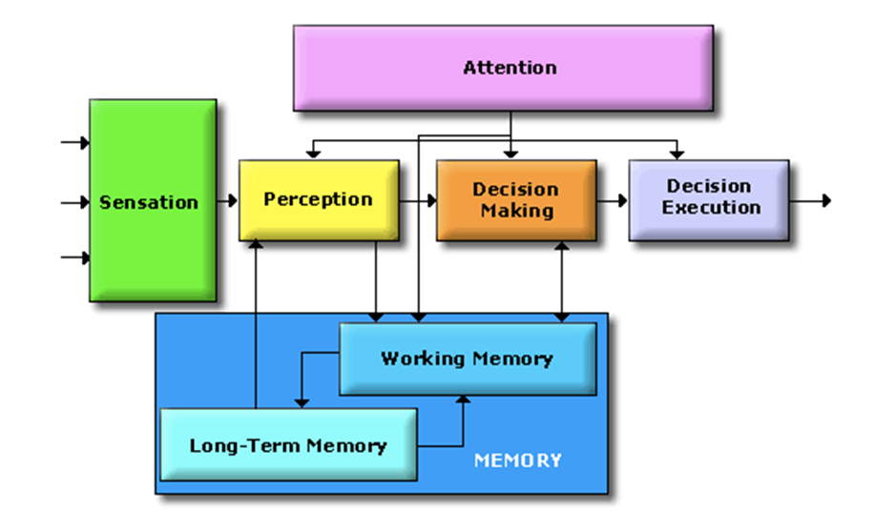
The Cognitive System
Cognitive scientists study intelligence and behavior, with a focus on how the nervous systems represent, processes, transforms, stores and recoveres information.
Essentially, information is captured by sensors
from where it is processed and in different ways:
Like data flowing through an
algorithm!
Key difference is the human minds
limited processing capacity which is
why we need attention! → Selection!
Not actually separate parts; nothing is truely separate, but
classification is how humans deal with information → r.i.p. us
Notes:
On the separate parts:
This approach is taken to aid clarity of explanation, but in so doing, can give the impression that individual aspects of cognition can be understood in isolation from each other. However, it is always important to remember that to properly understand the role of any single aspect of cognition we must appreciate how that role is dependent upon and interacts with other aspects.

Slide 7
Attention
Windows task manager for humans
Attention is how the brain controls its own information processing
Can be measured through conscious introspection, overt and implicit behaviors, electrophysiology and brain imaging
External attention – selection and modulation of sensory information
Selects locations in space, points in time, or modality-specific input
Feature-based or object-based
Integration of objects/features over space, time and modality
Internal attention – selection, modulation and maintenance of internally generated information
High-level cognitive (thoughts, plans, rules & responses, self-monitoring, memories)
Low-level cognitive (bodily functions – pain, hunger, etc.)

Slide 8
Attention
Windows task manager for humans; for our purposes
LIMITED CAPACITY – evolved out of necessity to focus limited processing capacity to the most important information
SELECTION – multiple stimuli compete for selection and the goal is to select the stimulus most relevant to current tasks and goals;
MODULATION – once a stimulus is selected, attention also determines how well it will be processed, how fast and how accurately, and whether it will be later remembered
VIGILANCE – closely related to modulation (which is limited in time and has immediate effects); the ability to sustain attention over extended periods of time

Slide 9
Attentional & Memory
So, what happens why you have attentively watched this lecture?
It was continually selected for perceptual processing; for storing in you short-term memory; declarative knowledge → you can retrieve and express it in language
Memory Type I processing: One of the types of rehearsal in the levels of processing approach, in which information is recirculated at the same level with no additional processing for depth. (repeat set of words)
If you then start applying it in class to design you perceptual model/computer vision information pipeline, then you are really learning; demonstratable knowledge
Memory Type II processing: According the levels of processing approach, this type involves recoding of information to another level of depth and leads to a more durable memory trace. (remember set of words)
However, if you get into a situation which is very attentional demanding you attentionally select other information for processing: Type I processing is overridden.
So that’s something we must avoid!
Smartphones and laptops are designed to be attentionally demanding.
However, perceiving little to no attentionally demanding stimuli helps: walking, looking at nature, meditation, counting sheep etc.

Slide 10

Good news!
I just scientifically proven that in order to learn well you should hand in your phone and close your laptop during and after the lectures!
Please hand them in now!

Slide 11
Today’s Schedule
Before the lecture please hand-in your phone and go for a brief 5 min walk. Afterwards: Free coffee. Tutorial? → Phones back!
Introduction to cognition
Lecture (afterwards 20-min walking break)
Perception
Lecture (afterwards 20-min walking break)
Tutorial: Create a flowchart for perceptual processing of sensory information for your robot!
Lunch
Learning
Lecture (afterwards 20-min walking break)
Tutorial: Create a flowchart for information; encoded perceptions, processing (a.k.a. learning) for your robot!
Fin!

Slide 12
What will we do this block?
Cognitive science deals with the mental faculties of language, perception, memory, attention, reasoning, and emotion
This block we will go into systems concerning:
Perception: Visual (& kinestaethic)
Memory: Learning
Reasoning: Decision-making
Emotion: Learning & motivation/goals setting
Next block we will go further into:
Language
Attention
Perception: Auditory

Slide 13
Break
Take a walk of 5 minutes and meet me at the Innovation Square!
Be back in 20 minutes for the perception lecture!

